Slide 1
Sentiment analysis on marketing
phase 5

Slide 2
Sentimental analysis on marketing
Course name: Artificial intelligence1
Team name:Proj_227125_Team_
Project name:Sentiment analysis on marketingProject
submitted to:Anna university / Nan mudhalvan
Year:lllDepartment:computer science and engineering
Semester:05
Group members:Mabika. R(212921104032)
Misba tharunam. S(212921104033)
Monica. T(212921104034)
Narmadha. D(212921104035)
Sandhiya. K(212921104042)
Sandhiya. S(212921104043)

Slide 3
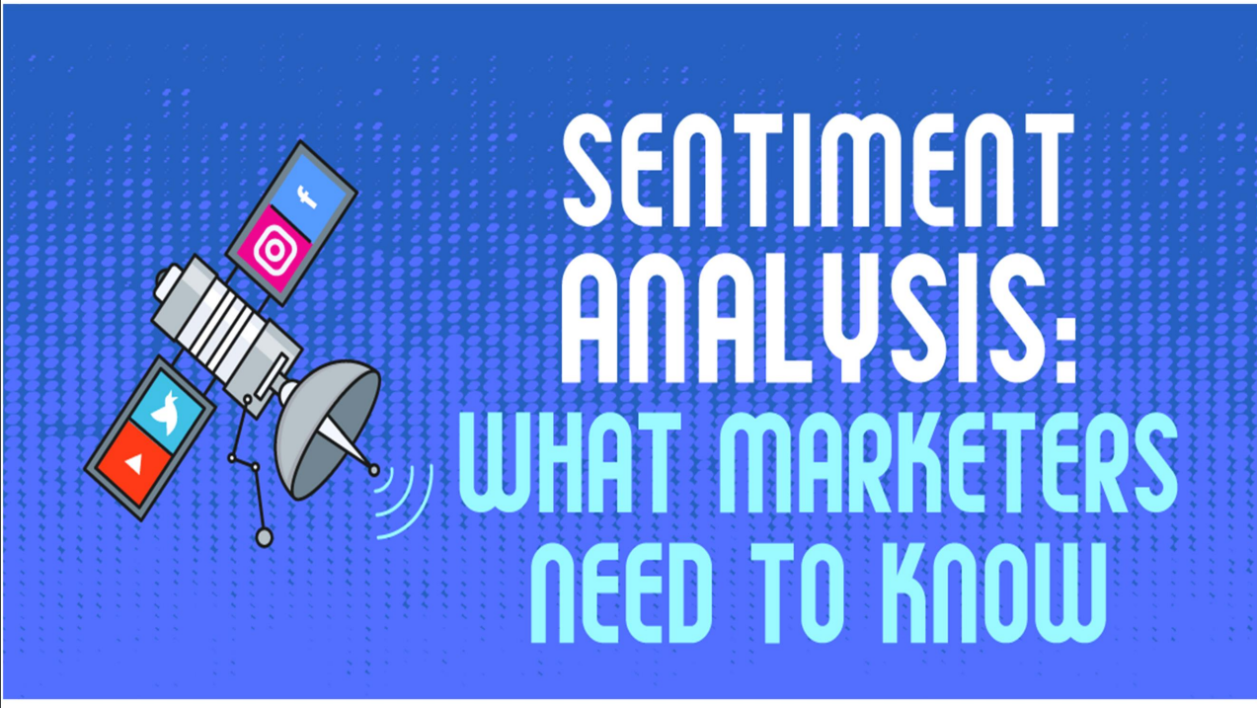

Slide 4
What is sentimental analysis?
Sentiment analysis is used to analyze raw text to drive objective quantitative results using natural language processing, machine learning, and other data analytics techniques. It is used to detect positive or negative sentiment in text, and often businesses use it to gauge branded reputation among their customers.
There are various types of sentiment analysis where the models focus on feelings and emotions, urgency, even intentions, and polarity. The most popular types of sentiment analysis are:
Fine-grained sentiment analysis
Emotion detection
Aspect based sentiment analysis
Multilingual sentiment analysis
Sentiment analysis is critical because it helps businesses to understand the emotion and sentiments of their customers. Companies analyze customers’ sentiment through social media conversations and reviews so they can make better-informed decisions. The Global Sentiment Analysis Software Market is projected to reach US$4.3 billion by the year 2027. Between 2017 and 2023, the global sentiment analysis market will increase by a CAGR of 14%.

Slide 5
The overall benefits of sentiment analysis include:
Sorting Data at Scale: With sentiment analysis, companies don't have to sort through customer support conversations manually, thousands of tweets, and surveys. Sentiment analysis helps businesses process vast amounts of data efficiently.
Real-Time Analysis: It helps to identify critical issues in real-time. For example, is a crisis on social media escalating? Is there an angry customer about to churn? With Sentiment analysis models, businesses can immediately identify customer pain points and take action right away.
Consistent criteria: A centralized sentiment analysis system can improve accuracy and deliver better insights since tagging text by sentiment is highly subjective, influenced by personal experiences, thoughts, and beliefs.

Slide 6
Applications of sentimental analysis
There is a wide range of applications for sentiment analysis. Some of them have been discussed in the following list.
Social Media- The comments on popular social media sites such as Instagram, Facebook, and Twitter are analyzed and then furthermore categorized into different segments, such as positive, negative, and neutral.
Customer Service- One of the perfect examples might include the comment section in the Google Playstore application, wherein comments from 1 to 5, are usually selected with the help of the various sentiment analysis approaches.
Marketing Sector- The marketing industry has benefited a lot from sentiment analysis. It has helped brand owners to understand the review of a product or service, and whether it has been categorized as good or bad by the consumers.

Slide 7
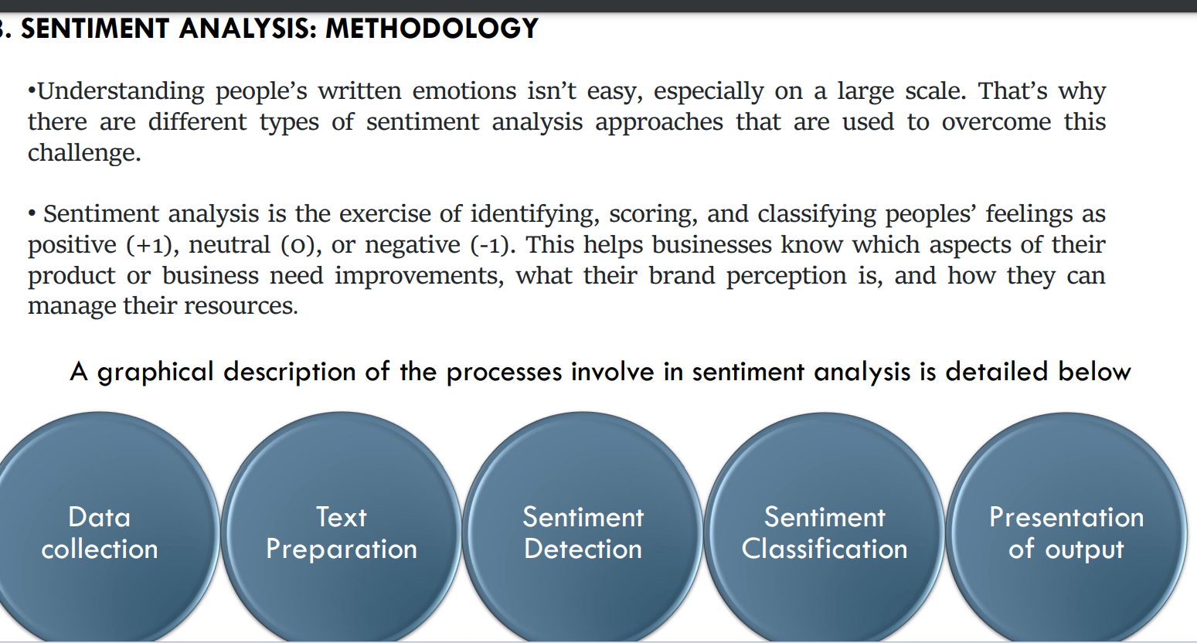
Methodology of sentimental analysis

Slide 8
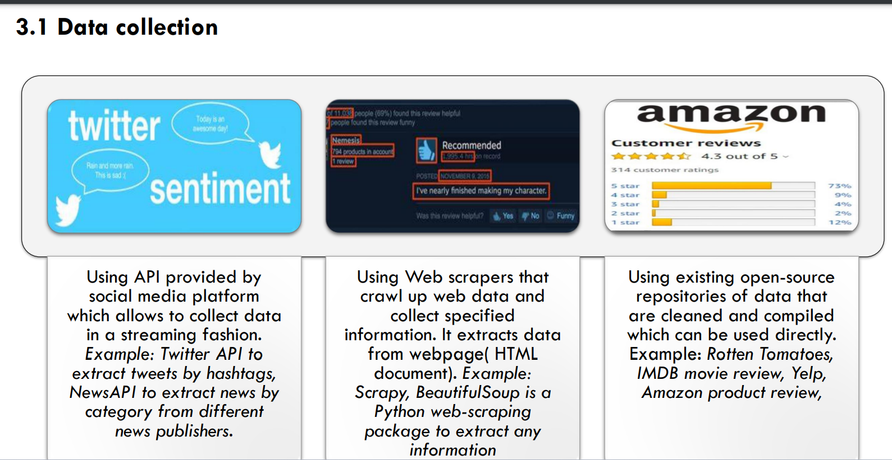

Slide 9
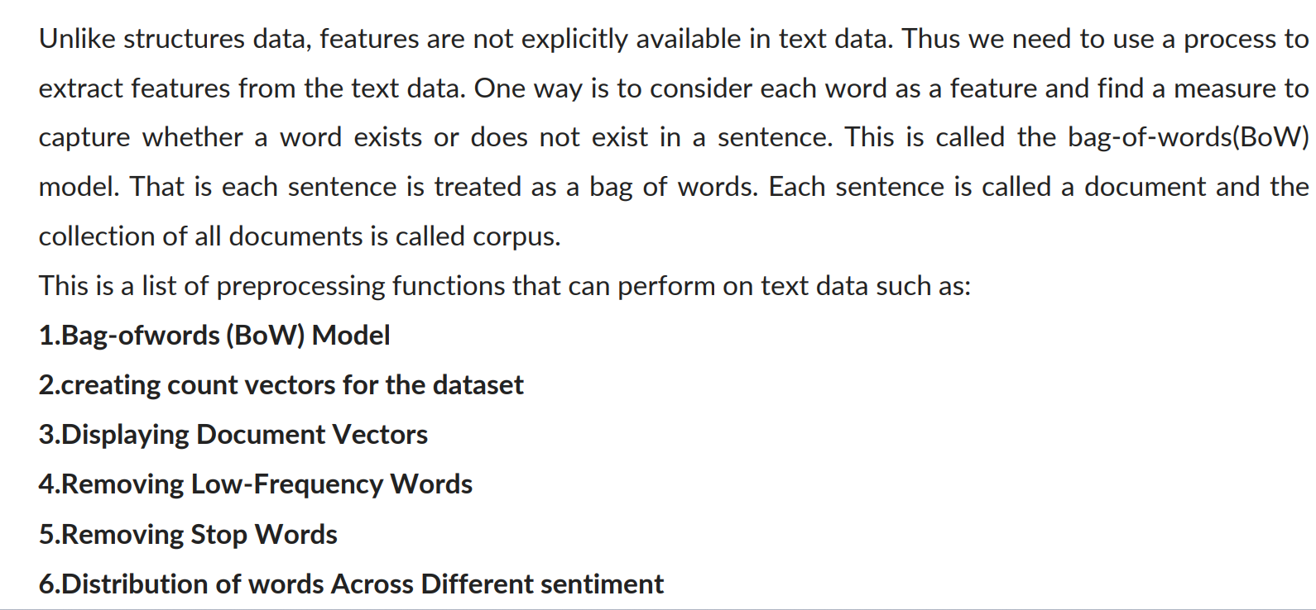
Text preprocessing

Slide 10
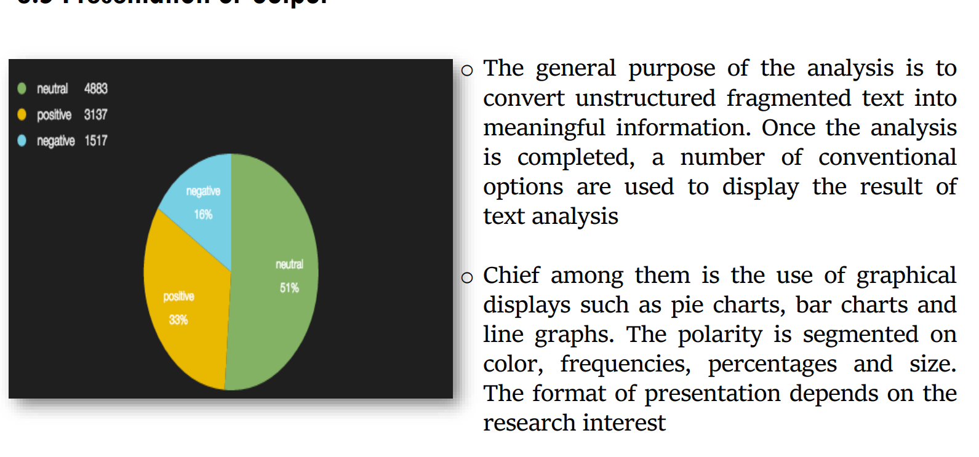
Presentation of output

Slide 11
Source definition and design thinking
Sentiment analysis for marketing involves analysing public sentiment towards a product, brand, or campaign to gain insights into customer opinions and preferences.
Design thinking
User-Centred Approach:
Design thinking puts the user at the center of the product development process. Sentiment analysis in marketing helps identify user sentiments, needs, and pain points, which can be valuable inputs for design thinking.
Empathy:
Design thinking emphasises empathy with users. Sentiment analysis provides data that allows marketers and designers to empathise with customers by understanding their feelings and opinions.

Slide 12
Define process
the design thinking process, the "Define" phase involves clearly defining the problem. Sentiment analysis can help a marketers define problems by uncovering negative sentiments or areas where customers are dissatisfied.
Ideation:
Sentiment analysis results can inspire ideation in design thinking. Positive sentiments can be used to identify features or aspects of a product that are appreciated by customers, while negative sentiments can drive brainstorming for improvements.
Prototyping:
Design thinking encourages rapid prototyping. Sentiment analysis can guide the creation of prototypes by highlighting what aspects of a product or service need enhancement

Slide 13
Testing and Feedback:
Sentiment analysis can be an ongoing process to gather feedback after implementing design changes. It helps evaluate whether design improvements have positively impacted customer sentiment.
Iterative Processes
Both sentiment analysis and design thinking promote iteration. Sentiment analysis can be used iteratively to continuously refine products and marketing strategies based on changing customer sentiment

Slide 14
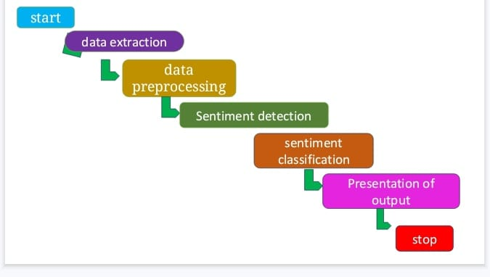
Innovation design

Slide 15
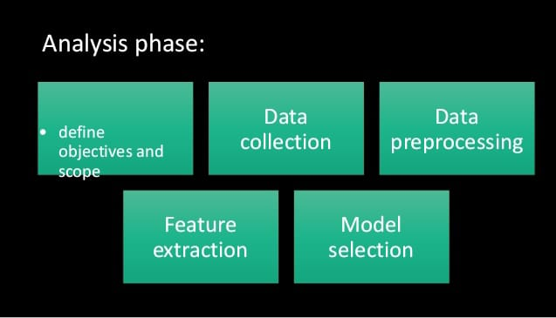
Analysis phase design

Slide 16
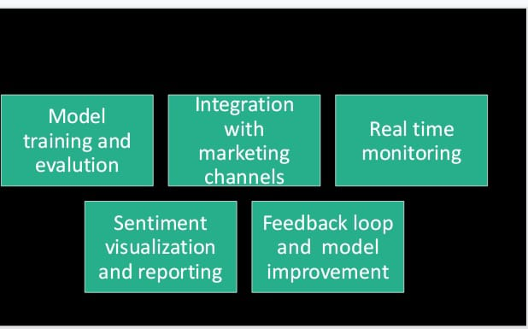
Analysis phase design

Slide 17
Devlopment phase
1.Define objectives and scope:
clearly outline the goals of sentiment
analysis.Are you focusing on social
media,customer reviews,or other
sources? What kind of insights are you
looking to gain?
2.Data collection:
data from various marketing
channels like social media,
customer reviews, surveys, and
feedback Gatherforms. Ensure the
data is diverse and representative
of your target audience.

Slide 18
3.Data Preprocessing
Clean and preprocess the data to
remove noise
irrelevantinformation,
and standardize
tex(e.g.lowercasing,
removing special characters,
stemming/lemmatization).
4.Future extraction
TechniquesConvert text data into
numerical format for analysis. Lik
TF-IDF(Term Frequency-Inverse
Document Frequency) or word
embeddings (e.g., Word2Vec, GloVe) can be used.

Slide 19
5.model selection:
Choose an appropriate sentiment
analysis model. Common choices
include:Rule-based systems
Machine learning algorithms (e.g.,
Support Vector Machines, Naive Bayes,
Neural Networks)
Pre-trained models like BERT, GPT-3, etc.
6. Model training and evalution:
Use labeled data to train the
chosen model. Split the data into
training and testing sets for evaluation. Employ metrics like
accuracy, precision, recall, and F1-score to assess performance.

Slide 20
7.Integration with marketing channels:
implement the sentiment analysis
into the marketing workflow. This
could involve APIs, custom scripts,
or specialised software.
8.Real time monitoring:
Setup continuous monitoring of
selected channels (e.g., social media
platforms, review sites) for incoming data

Slide 21
9.Feedback loop and model improvement:
Regularly review the results and
gather feedback to fine-tune the system. Re-train the model with updated data if needed.
10.Sentimental visualization and reporting:
Create visualizations (e.g., charts
, graphs) to convey sentiment
trends over time or in response to
specific campaigns.

Slide 22
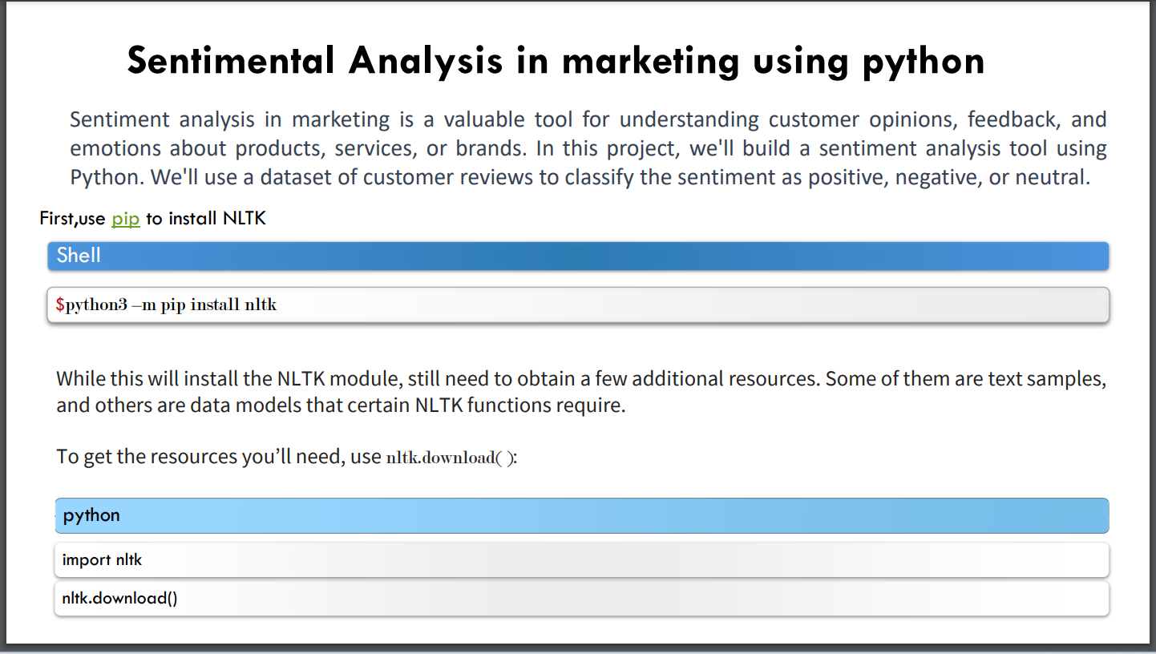

Slide 23
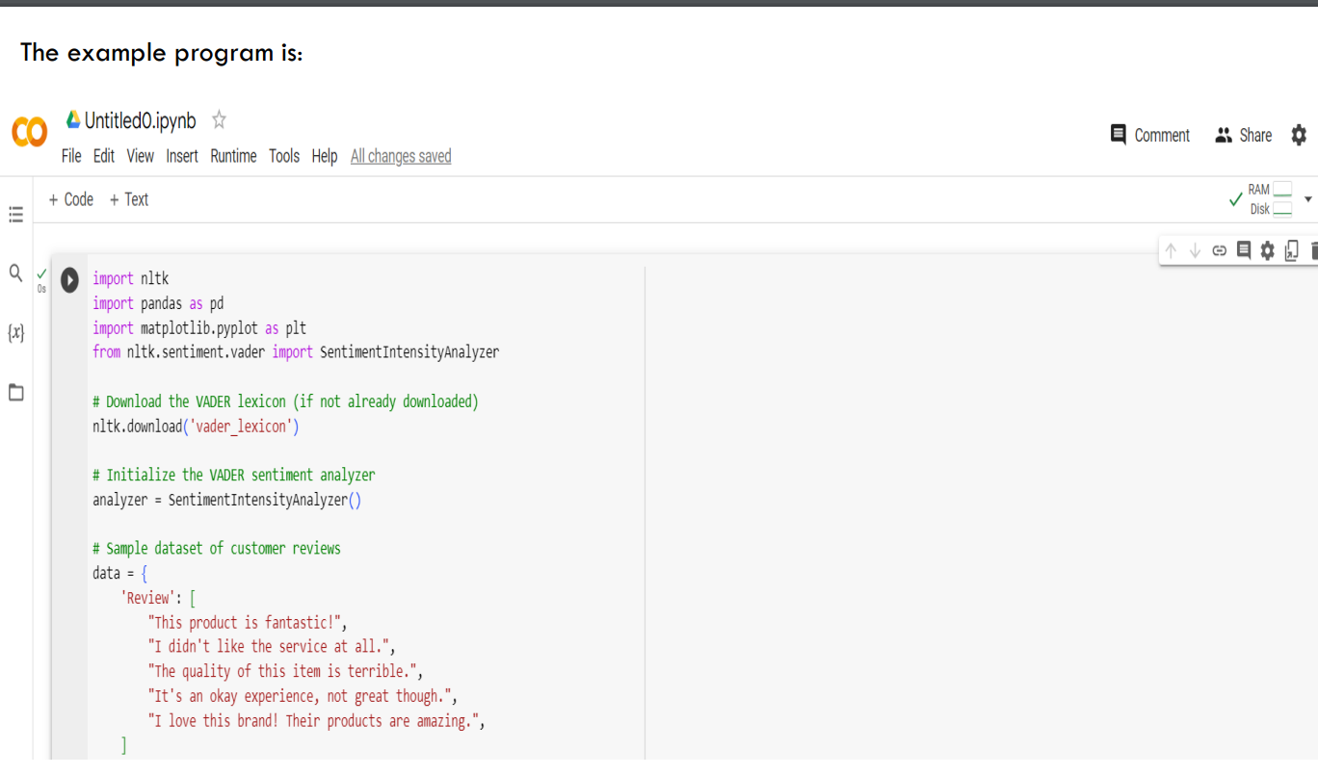

Slide 24
Dataset
Twitter Sentiment Analysis
In the first advanced sentiment analysis project, you'll learn how to make a Twitter sentiment analysis project using Python. Twitter helps corporations, businesses, and governments to get public opinion on any trending topic. For this Twitter sentiment analysis Python project, you should have some basic or intermediate experience in performing opinion mining.
You must also have some experience with RESTful APIs since Twitter API is required to extract data. The project also uses the Naive Bayes Classifier to classify the data later in the project. It's a time-consuming project but will show your expertise in opinion mining.
Start with getting authorized credentials from Twitter, create the function, and build your first test set using the Twitter API. Unless you know how to use deep learning for non-textual components, they won't affect the polarity of sentiment analysis. Remove duplicate characters and typos since data cleaning is vital to get the best results. Use the Naive Bayes Classifier for analyzing the sentiment. Finally, test your model and see whether it's producing the desired results.
Performing sentiment analysis on tweets is a fantastic way to test your knowledge of this subject. It'll be a great addition to your data science portfolio (or CV) as well.

Slide 25
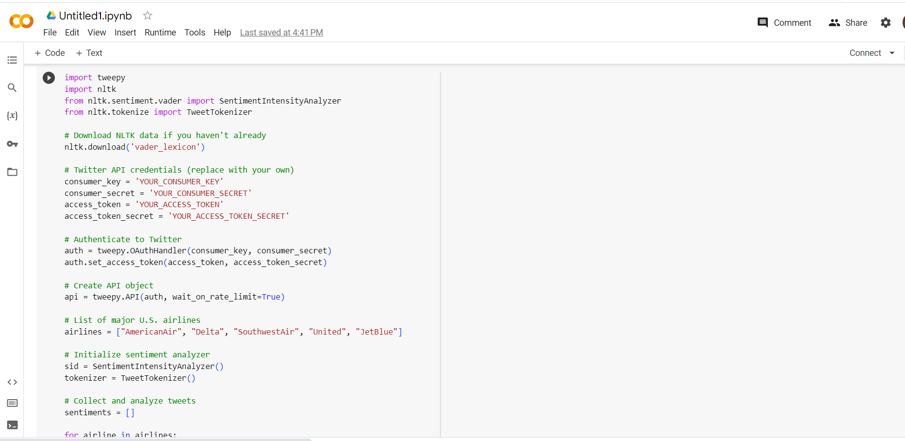
code

Slide 26
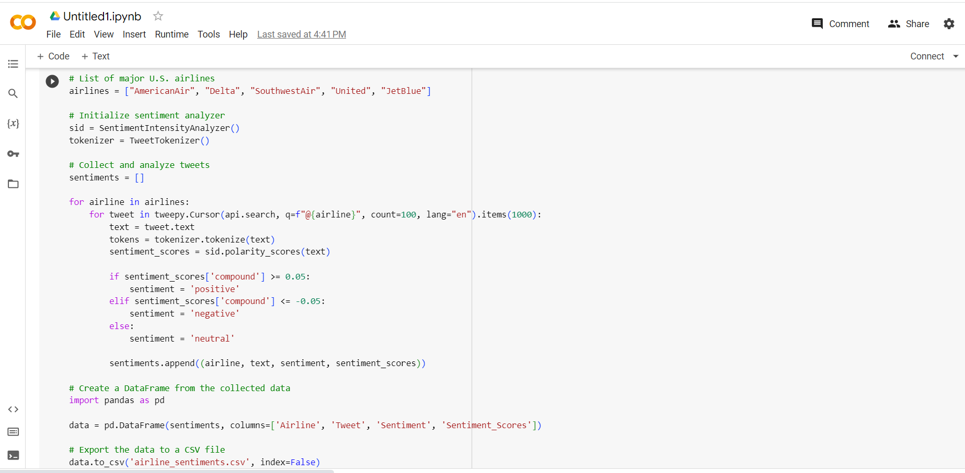

Slide 27
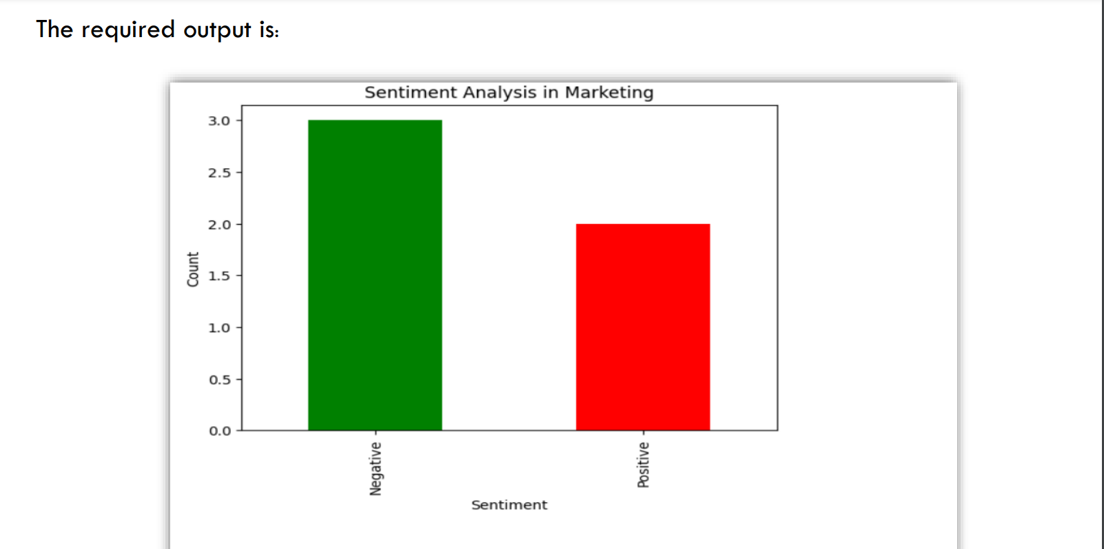
output

Slide 28
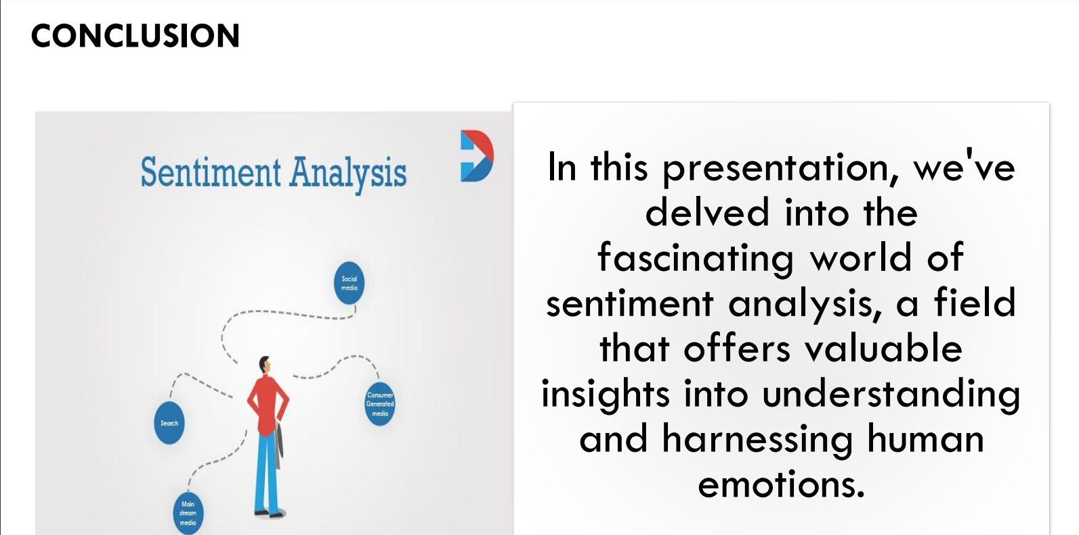
conclusion

Slide 29


Slide 30
With regards :
Team name:Proj_227125_Team_

